Slide 1

New Year Resolutions
Presented by: Sarah Mahdi
Python Course 3-11
Notes:
Picture sourced from DALL.E

Slide 2
Agenda
Introduction
Problem Statement and Hypothesis
Data Description
Data Preprocessing
Exploratory Data Analysis (EDA)
Feature Engineering
Challenges and successes
Conclusions and Key learnings
Q&A
Python Course 3-11

Slide 3
Introduction
Purpose of the Study
Understanding Societal trends in resolutions & identify aspirations
Objective
Analyze Twitter resolutions dataset
Key questions:
Common type of resolutions?
Variations by gender and locations?
Most engaging resolutions?
Scope
Kaggle New Year Resolutions dataset
Focusing on engagement and demographics
Python Course 3-11
Notes:
Purpose of the Study
Motivation: Mention that New Year resolutions are a common tradition and can reveal a lot about people's priorities and aspirations.
Relevance: Highlight why it's interesting to study these resolutions, such as understanding societal trends and identifying common goals.
Objective
Aim: aim is to analyze the resolutions dataset.
Key Questions: answer questions seeking to answer through the analysis.
Scope
Dataset: describe the dataset and mentioning its source (Kaggle).
Focus: Summarize the specific aspects of the data you will be analyzing, such as categories of resolutions, demographic variations, and social media engagement.

Slide 4
Problem Statement and Hypothesis
Investigating New Year resolutions by analyzing Twitter data:
Analyzing Twitter data to explore resolutions
Identifying the top 10 most retweeted resolutions
Hypothesis:
Resolutions related to personal growth are more popular and widely shared on social media.
Personal growth resolutions have a broad appeal and more motivational
Python Course 3-11
Notes:
Problem Statement
Context:
Highlighting the widespread practice of making New Year resolutions and their significance in understanding societal and individual trends.
Objective:
Clearly state the goals of the project:
Analyzing Twitter data to explore New Year resolutions.
Identifying the top 10 most retweeted resolutions.
Determining the states with the highest number of tweets about New Year resolutions.
Hypothesis
Hypothesis:
State your hypothesis clearly:
Resolutions related to personal growth are more popular and widely shared on social media.
Provide reasoning for your hypothesis:
Personal growth resolutions have a broad appeal and are motivational, making them more likely to be shared and engaged with on social media platforms.

Slide 5
Data Description
Analyzing patterns in New Year's resolutions based on social media data (Twitter)
The dataset sourced from Kaggle, which includes a The dataset comprises data from over 5000 tweets
This dataset provides eight different characteristics for each resolution tweet, including the tweet ID, user's name, gender, the category of resolution, the text of the tweet, retweet count, tweet creation date, and the state from which the tweet was posted.
Python Course 3-11
Notes:
I'm planning to analyze patterns in New Year's resolutions based on social media data (Twitter)
I have a dataset sourced from Kaggle, which includes a variety of resolutions posted on Twitter around the New Year.
The dataset comprises data from over 5000 tweets, encapsulating diverse resolutions across several categories such as Health & Fitness, Personal Growth, and Humor.
This dataset provides eight different characteristics for each resolution tweet, including the tweet ID, user's name, gender, the category of resolution, the text of the tweet, retweet count, tweet creation date, and the state from which the tweet was posted.
The retweet_count field look like it has missing values, indicating that some tweets' popularity metrics are incomplete. Also, (text field) is varied and unstructured, requiring cleaning and standardization to facilitate text analysis. This includes handling hashtags, mentions, and URLs within the tweets.

Slide 6
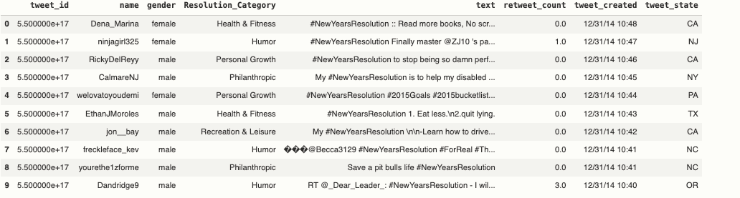
Data Description
..
Python Course 3-11
Notes:
I'm planning to analyze patterns in New Year's resolutions based on social media data (Twitter)
I have a dataset sourced from Kaggle, which includes a variety of resolutions posted on Twitter around the New Year.
The dataset comprises data from over 5000 tweets, encapsulating diverse resolutions across several categories such as Health & Fitness, Personal Growth, and Humor.
This dataset provides eight different characteristics for each resolution tweet, including the tweet ID, user's name, gender, the category of resolution, the text of the tweet, retweet count, tweet creation date, and the state from which the tweet was posted.
The retweet_count field look like it has missing values, indicating that some tweets' popularity metrics are incomplete. Also, (text field) is varied and unstructured, requiring cleaning and standardization to facilitate text analysis. This includes handling hashtags, mentions, and URLs within the tweets.

Slide 7
Data Preprocessing & EDA
Data Cleaning
Handling missing values
Removing Duplicates
Data Filtering and displaying for each state
Filters tweets by states & gender
Filter by text
Grouping and Aggregation
Determine number of tweets from each state
Analyzing the most popular resolution
Discovering the Number 1 tweet
Analyzing the gender distribution for retweeted tweets
Python Course 3-11
Notes:
1. Data Cleaning:
To ensure the quality and consistency of the dataset, the following data cleaning steps were performed:
Handling Missing Values: Rows with missing values in critical columns (tweet_state, text, retweet_count) were dropped to maintain the integrity of the analysis.
Removing Duplicates: Duplicate rows were removed to avoid redundancy and ensure unique data entries.
Correcting Errors: The tweet_created column was converted to datetime format for accurate date and time analysis. Also, it will be in Ascending order.
Transforming Data: The text column was converted to lowercase to standardize the text data and facilitate consistent analysis. However; decided to keep the mention @ in case someone trying to reach a specific person.
2. Data Filtering and Displaying for Each State:
Filtering by State: Filters the dataset to include only tweets from each state.
Truncating Text: Limits the text length to 100 characters for display purposes.
Generating HTML Table: Creates an HTML table with enhanced styling using tabulate.
Displaying and Saving: Displays the HTML table and saves the filtered data to a CSV file for each state.
3. Grouping and Aggregation:
The data was grouped and aggregated to identify key patterns and insights:
Grouping by States: The number of tweets from each state was counted to determine the regional distribution of New Year resolutions.
Grouping by Gender: The tweets were grouped by gender to analyze gender-based differences in resolutions.
Grouping by Resolution Category: The tweets were grouped by resolution categories to understand which types of resolutions were most popular.
4. Data Filtering by Clean Text:
To focus on specific content within the tweets, data filtering was performed:
Filtering Clean Text: Tweets were filtered to include only clean text, removing any extraneous characters and ensuring that the analysis focused on meaningful content.
5. Data Filtering to Include Hashtags, Mentions, and URLs:
Further filtering was done to include tweets with specific features:
Filtering Text with Hashtags, Mentions, and URLs: Tweets containing hashtags, mentions, and URLs were identified to analyze how these elements might influence engagement and popularity.
Exploratory Data Analysis (EDA)
1. Visualizing Null Values:
Bar chart of Null Values: A bar chart was created to visualize the presence of null values across different columns in the dataset.
2. Analyzing Tweets by State:
Regional Distribution of Tweets: The number of tweets from each state was visualized to understand regional differences in New Year resolutions.
Top State Analysis: Identified and visualized the state with the highest number of tweets.
3. Analyzing Tweets by Gender:
Gender Distribution of Tweets: The number of tweets by gender was visualized to analyze gender-based differences in resolutions.
4. Analyzing Resolution Categories:
Popularity of Resolution Categories: The distribution of tweets across different resolution categories was visualized to identify the most popular types of resolutions.
Top Resolution Category: Identified and visualized the most popular resolution category.
5. Top Retweeted Tweets Analysis:
The top 10 most retweeted tweets were identified to understand which resolutions garnered the most attention and engagement:
Overall Top Retweeted Tweets: The top 10 most retweeted tweets were identified to highlight the most popular tweets by resolutions category on Twitter.
Total Number of Tweets by State: The top 10 states with the highest number of tweets were identified to understand regional variations in engagement.
Top Retweeted Tweets by Gender: The genders associated with the top 100 most retweeted tweets were analyzed to identify any gender-based patterns in popular resolutions.

Slide 8
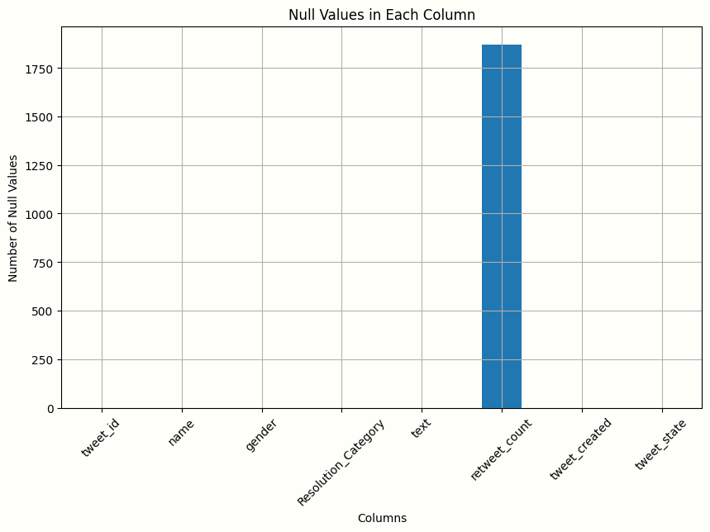
Data Preprocessing & EDA
Python Course 3-11
Notes:
Bar Chart with 1872 rows missing retweet count

Slide 9
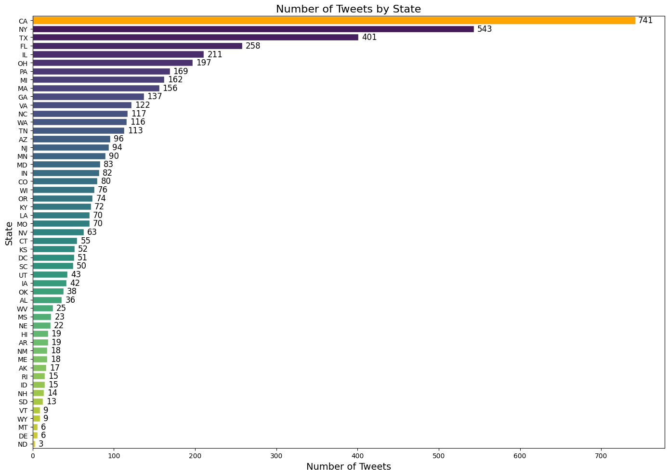
Data Preprocessing & EDA
CA take the first place with 741 tweets
NY has the second place with 543 tweets
TX has the third place with 401 tweets
Python Course 3-11
Notes:
Bar chart showing CA takes the number 1 place

Slide 10
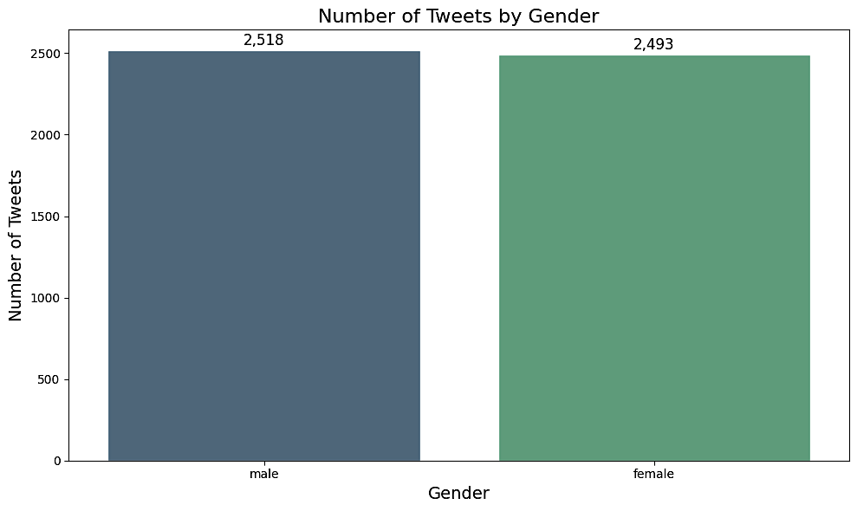
Data Preprocessing & EDA
Male: 2,518
Female: 2,493
Python Course 3-11
Notes:
Bar chart

Slide 11
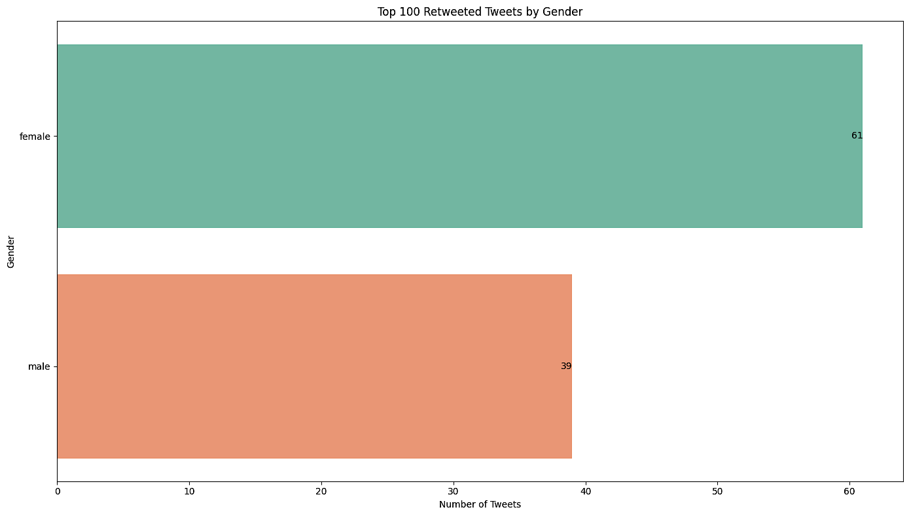
Data Preprocessing & EDA
For Retweeting Tweets:
Female: 61
Males: 39
Python Course 3-11

Slide 12
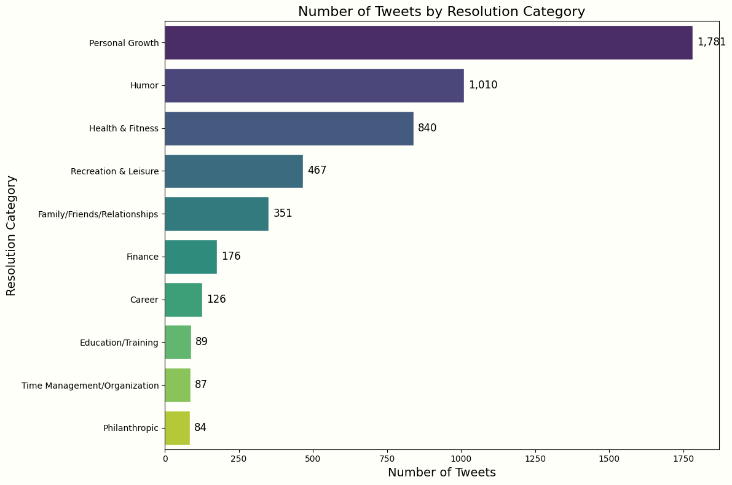
Data Preprocessing & EDA
Personal Growth is the
Winner
Python Course 3-11
Notes:
Bar chart showing 1781 for Personal Growth

Slide 13
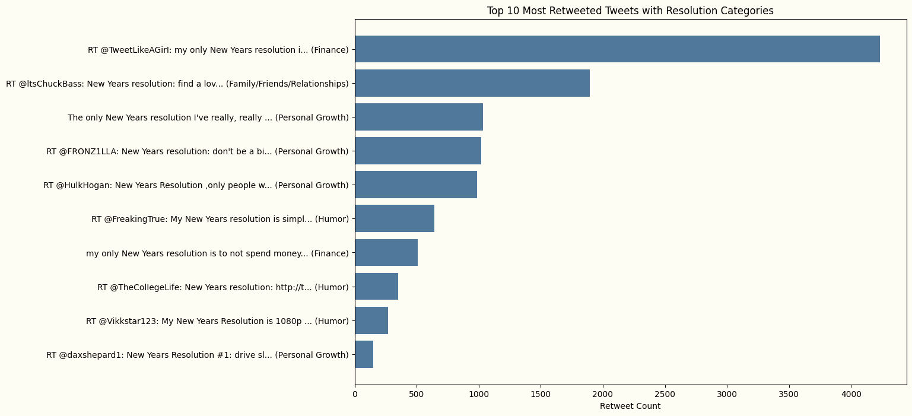
Data Preprocessing & EDA
Python Course 3-11
Notes:
Bar chart : Most Retweeted Tweet: RT @TweetLikeAGirI: my only New Years resolution is to not spend money on food I honestly might be rich by 2016 Retweets: 4234.0 State: TX Gender: female Resolution Category: Finance

Slide 14
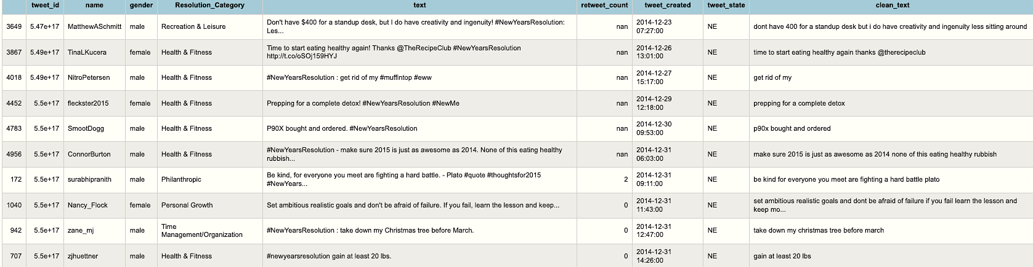
Data Preprocessing & EDA
Python Course 3-11
Notes:
This is the dataset after filtering by each state and converting empty values to Nan

Slide 15
Feature Engineering
Analyze the text of the tweets to identify common words.
Develop a rule-based or machine learning model that recommends fitness apps or websites if specific keywords are mentioned.
Python Course 3-11
Notes:
Purpose: To extract additional meaningful information from existing data.
Approach: Analyze the text of the tweets to identify common words or phrases that might indicate a resolution's seriousness or likelihood to be maintained.
Recommendation System: Develop a rule-based or machine learning model that recommends fitness apps or websites if specific keywords are mentioned.

Slide 16
Challenges and successes
Deciding whether to delete or keep null values
Identifying the origin and author of the most popular tweet
Determining the state with the highest number of tweets:
Filtering by each state
Python Course 3-11
Notes:
Deciding whether to delete or keep null values: One of the challenges faced was determining whether to retain or remove rows with null values. This decision was crucial as it impacted the integrity and completeness of the data analysis.
Identifying the origin and author of the most popular tweet: Successfully implemented a method to locate the most retweeted tweet, providing insights into the geographic origin and demographic (gender) of the user who posted it.
Determining the state with the highest number of tweets: Developed a procedure to count and visualize tweets by state, enabling the identification of the state with the highest tweet activity. This analysis highlighted regional trends and user engagement.
Filtering: Filters the dataset to include only tweets from each state was not an easy task to do, it took longer than anticpated. Had to increase the Increase the IOPub data rate limit to run the code as well

Slide 17
Conclusions and key learnings
Popularity of Personal Growth Resolutions
State-wise Tweet Distribution
Common Resolution Themes
Number 1 Retweeted Tweet
Data Analysis (DA) with Python and Pandas
Python Course 3-11
Notes:
- Popularity of Personal Growth Resolutions:
Personal growth resolutions emerged as the most popular category, indicating a widespread interest in self-improvement among Twitter users.
2- State-wise Tweet Distribution:
California has the highest number of tweets related to New Year resolutions, suggesting regional differences in how people engage with New Year resolutions on social media.
3- Common Resolution Themes:
Other common resolution themes include health and fitness, career, and education/training, reflecting areas where individuals commonly seek to make changes at the start of a new year.
4 - Number 1 Retweeted Tweet:
Female from Texas takes the spot for the number 1 retweeted tweet with 4234 and it falls under the category of finance
5 -Data Analysis:
Performing Data Analysis (DA) with Python and Pandas is significantly more efficient than manually examining a document to extract the insights mentioned above.

Slide 18
Resources & Thanks
Link to project: https://github.com/sarahamer13/GA-Final-Project
Thanks to BingYune for his guidance and extreme patience and thanks to all the classmates
Python Course 3-11

Slide 19
Questions
Python Course 3-11

